Slide 1

Analysis of Trump Tweets
Joey Livorno

Slide 2
Introduction
During the second day of his impeachment hearing, Donald Trump sent a record 142 tweets (MarketWatch)
Twitter is an excellent source for Linguistic data
One of the most notorious Twitter users just so happens to be our President
Donald Trump’s Twitter page is filled with data that is simply begging to be analyzed

Slide 3
My Motivation
I’m an Information Science Major
I’m addicted to Twitter
Donald Trump is constantly in the limelight
I’m not very interested in politics
But what better way to learn more?

Slide 4
Background Information
Donald Trump is the 45th President of the United States
He began his first presidential campaign in 2015
Donald Trump uses his Twitter in for ways that no other President has done
Obviously, Barack Obama was the only other President to have this tool
He uses it to keep the American people constantly engaged in what he is thinking and doing

Slide 5
Background Information (cont.)
Donald Trump has been tweeting since 2009
Most of his tweets were made after 2015
He is notorious for using his Twitter recklessly
Are there any conclusions we can draw from all this data?

Slide 6
Project Proposal
Analyze Donald Trump’s Twitter feed
Draw conclusions about his tweeting habits:
Trends
Sentiment
Machine Learning Model

Slide 7
Hypotheses:
Donald Trump’s twitter influence most likely has grown overtime
A sentiment analysis of his tweet’s regarding certain issues should be consistent with the idea that he “flip flops” (i.e. he changes stances on issues when convenient)
Donald Trump’s unique tweeting style should allow for a successful prediction model when compared to other tweets

Slide 8
Tools
Pandas, NumPy, nltk
TextBlob
Scikit-learn
TfidfVectorizer
Multinomial Naïve Bayes
GridSearchCV

Slide 9

A short description of textblob
A python library for processing textual data
Provides a simple way to access elements of Natural Language Processing
Part of speech tagging
Noun phrase extraction
Sentiment analysis
I use TextBlob to expedite sentiment analysis

Slide 10
Data Processing
First option to gather this data would be TweePy
Much more work-intensive
Limited to 3200 tweets
Trump’s twitter feed is already well documented on the internet
Trump Twitter Archive
44,000 Tweets
Includes retweets
Followthehashtag
200,000 tweets
Comes from random Twitter users

Slide 11
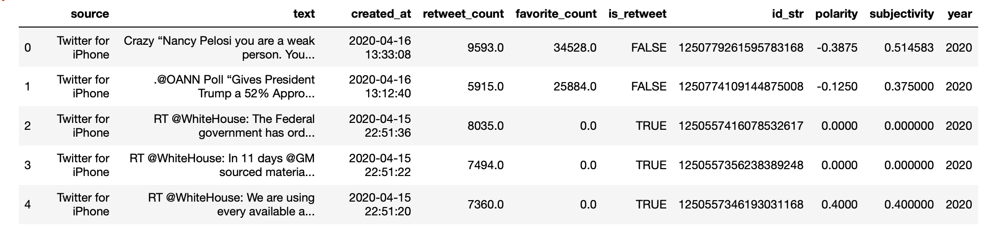
Data Processing (cont.)
Download tweets as .csv
Add necessary columns
Polarity
Subjectivity
Year
Tokenize and lowercase

Slide 12
Data Processing (Cont.)
I then created subsets for various political topics
Russia
Russia, Moscow, putin
716 tweets
Iran
Iran, Tehran, nuclear deal, rouhani
437 tweets
China
China, Beijing, xi, jinping
1638 tweets

Slide 13
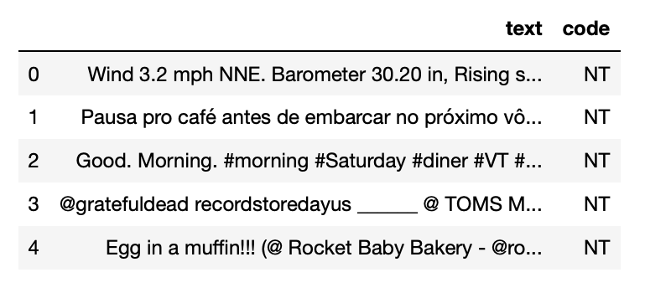
Data Processing (cont.)
Read in generic tweets as .csv
Place tweet content of each set in separate dataframes
Tag Trump tweets as T and others as NT
Concatenate the dataframes
Pickle

Slide 14
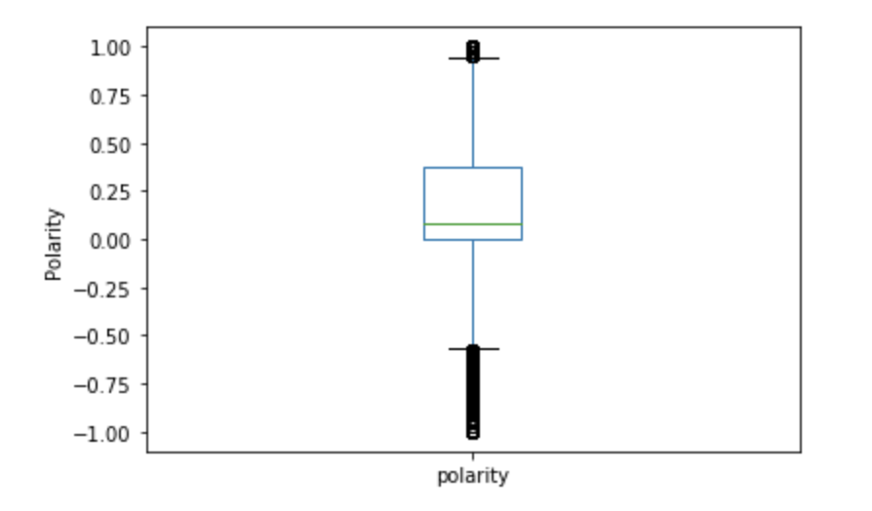
Exploratory Data Analysis
Began with .describe()
Average sentiment was about .17
Median was about .08
Because median is less than mean, we can expect the data to be skewed right
Counterintuitive to what we would expect from Trump’s twitter
An interesting first discovery

Slide 15
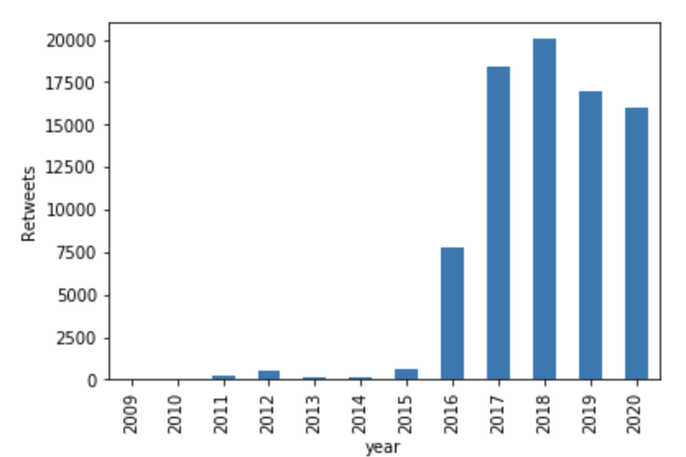
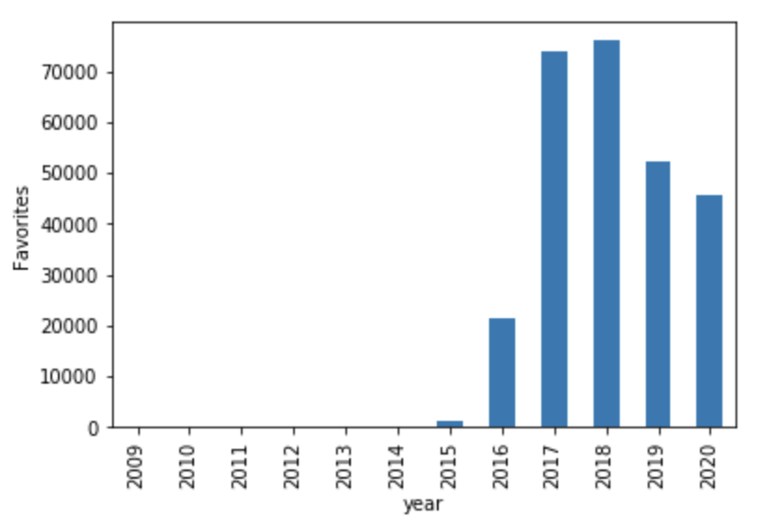
Exploratory Data Analysis (cont.)
2019 was when he tweeted the most, but average tweet was in August 2015
Data is incomplete, but 2018 showed his most retweets and favorites
Most favorited and retweeted tweet
369,530 retweets
879,647 favorites

Slide 16
Exploratory Data Analysis (cont.)
Learned basic statistics of Trump’s Twitter
Trends are consistent with the idea that his influence has grown overtime
Interesting, but nothing is very conclusive

Slide 17
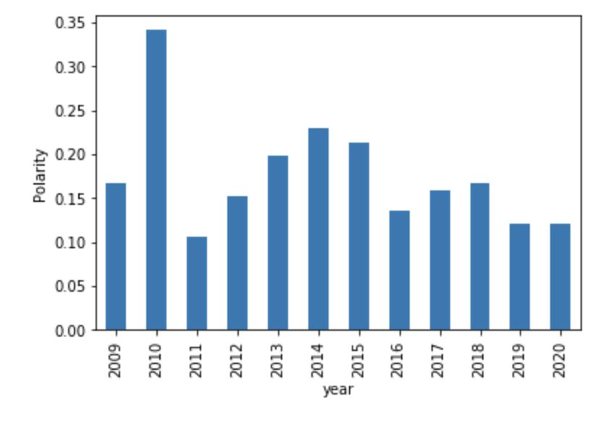
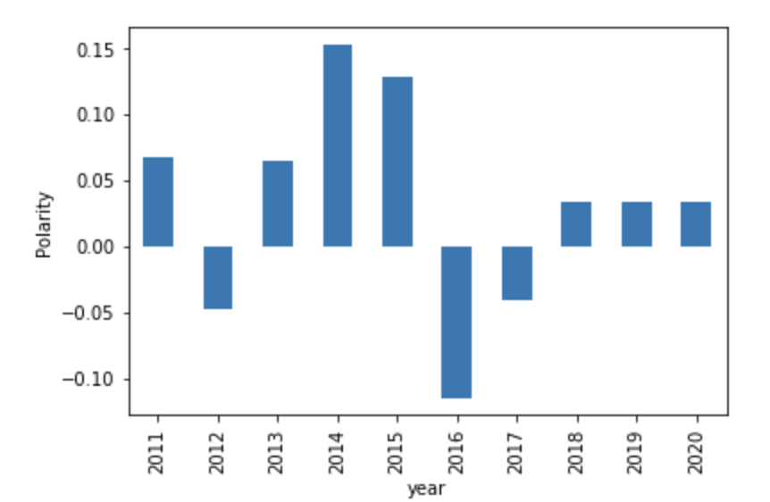
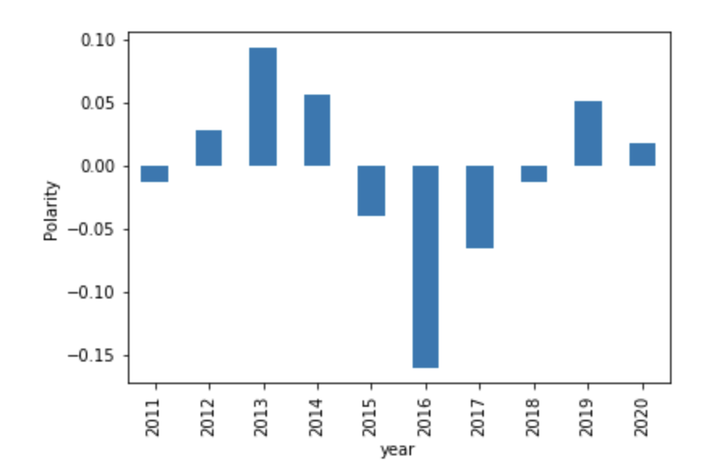
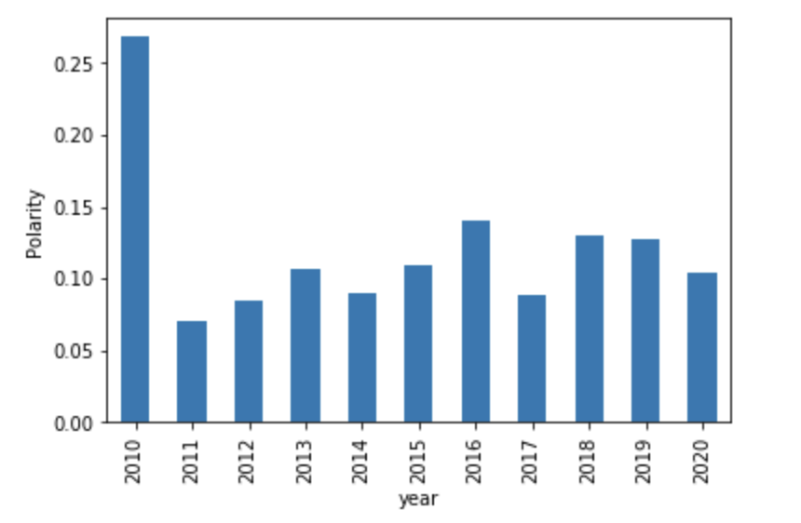
Linguistic Analysis
Overall
Russia
Overall sentiment by year shows that other than 2009 and 2010, twitter has remained mostly high-neutral
Russia
Big drop off from 2014-2016
2019 was a significant increase
Iran consistently low
2016 showed the lowest
2019 abnormally high
China was consistently high neutral
Iran
China

Slide 18
Linguistic Analysis (cont.)
I would’ve expected China to be lower
I cannot yet explain why Iran was so high in 2019
Conflict began in early 2020
Perhaps they were not yet on Trump’s “shitlist”
Russia is the most conclusive
Dropped significantly at the start of his campaign
Increase after 2017 might relate to the Mueller Investigation and Report

Slide 19
Machine Learning
I split the concatenated dataframe into two series
Created the pipeline consisting of TfidfVectorizer and MultinomialNB
Created parameter dictionary
Fit the GridSearchCV with the data
Changed Tfidf max_features and MNB alpha
5 folds

Slide 20
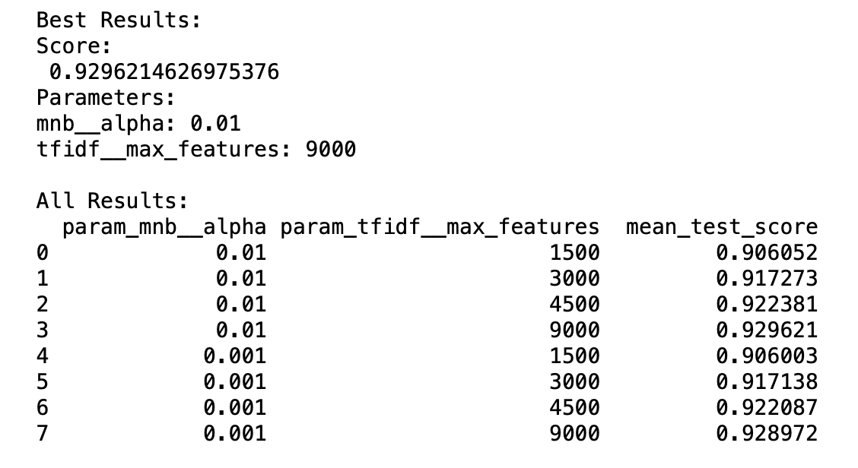
Machine Learning (cont.)
Best result was about 93%
Mnb__alpha: .01
Tfidf__max_features: 9000
MNB alpha value had a small impact, but .01 yielded slightly higher accuracy
Accuracy increased directly with max features
Possibly true for many people, but significant nonetheless

Slide 21
Key Takeaways
Trump’s Twitter influence has increased drastically since he started his first presidential campaign
Trump uses this influence and strong language to defend his friends and attack his enemies
Trump’s tweets are easily identifiable when compared to others

Slide 22
Still to Do
Incorporate random tweets into analysis to form a baseline
Group tweets more generally by sentiment to show broader trends (low, low-neutral, high-neutral, high)
Apply machine learning to new labels
Become more familiar with events that may better explain the data

Slide 23
Conclusion
Politicians have a lot of online influence
Our tweets don’t directly affect people
With influence like Trump, tweets can have a direct effect on certain groups
It’s important to be aware of this influence and check those who are in positions to use it negatively

Slide 24
Sources
http://www.trumptwitterarchive.com/archive
http://followthehashtag.com
https://www.marketwatch.com/story/this-is-trump-unleashed-these-charts-show-that-the-president-is-tweeting-and-speaking-more-than-ever-2019-09-23
https://www.axios.com/mueller-russia-investigation-timeline-indictments-70433acd-9ef7-424d-aa01-b962ae5c9647.html
https://textblob.readthedocs.io/en/dev/

